Slide 1
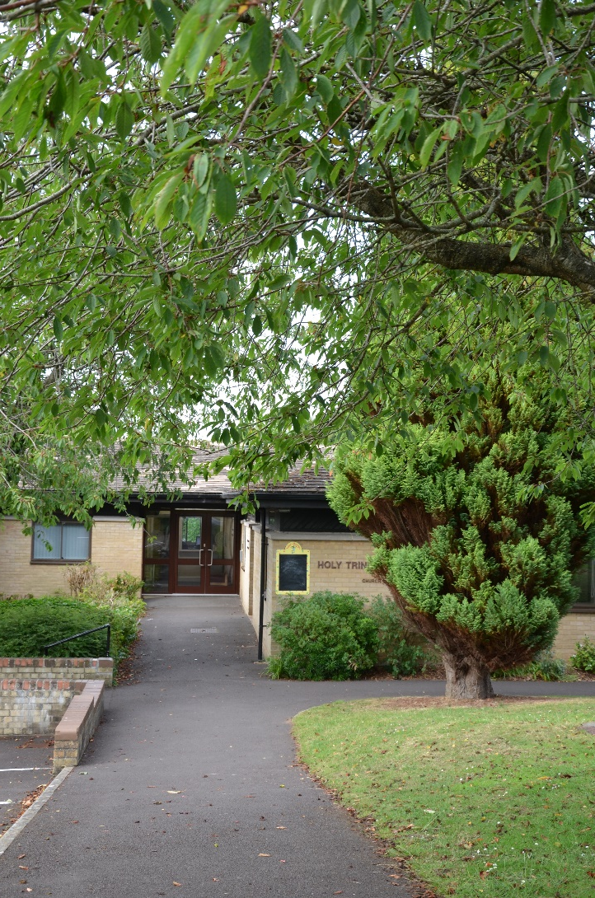
Holy Trinity
Church School
WELCOME

Slide 2

Rainbow Values

Slide 3
Welcome Sessions
  You and your child will be invited to three welcome sessions in school.
  These will take place during May, June and July and will be from 3.30pm until 4pm in Classes 1 and 2.
  These sessions will give you and your child a chance to meet the teachers and get to know the school environment.
  This will encourage a smooth transition into school.

Slide 4
Our Themes
Autumn Term
  1st half – All About Me
  2nd half – Count Down to Christmas
Spring Term
  1st half – Superheroes
  2nd half – People who Help us
Summer Term
  1st half – Marvellous Minibeasts
  2nd half – On the Farm

Slide 5
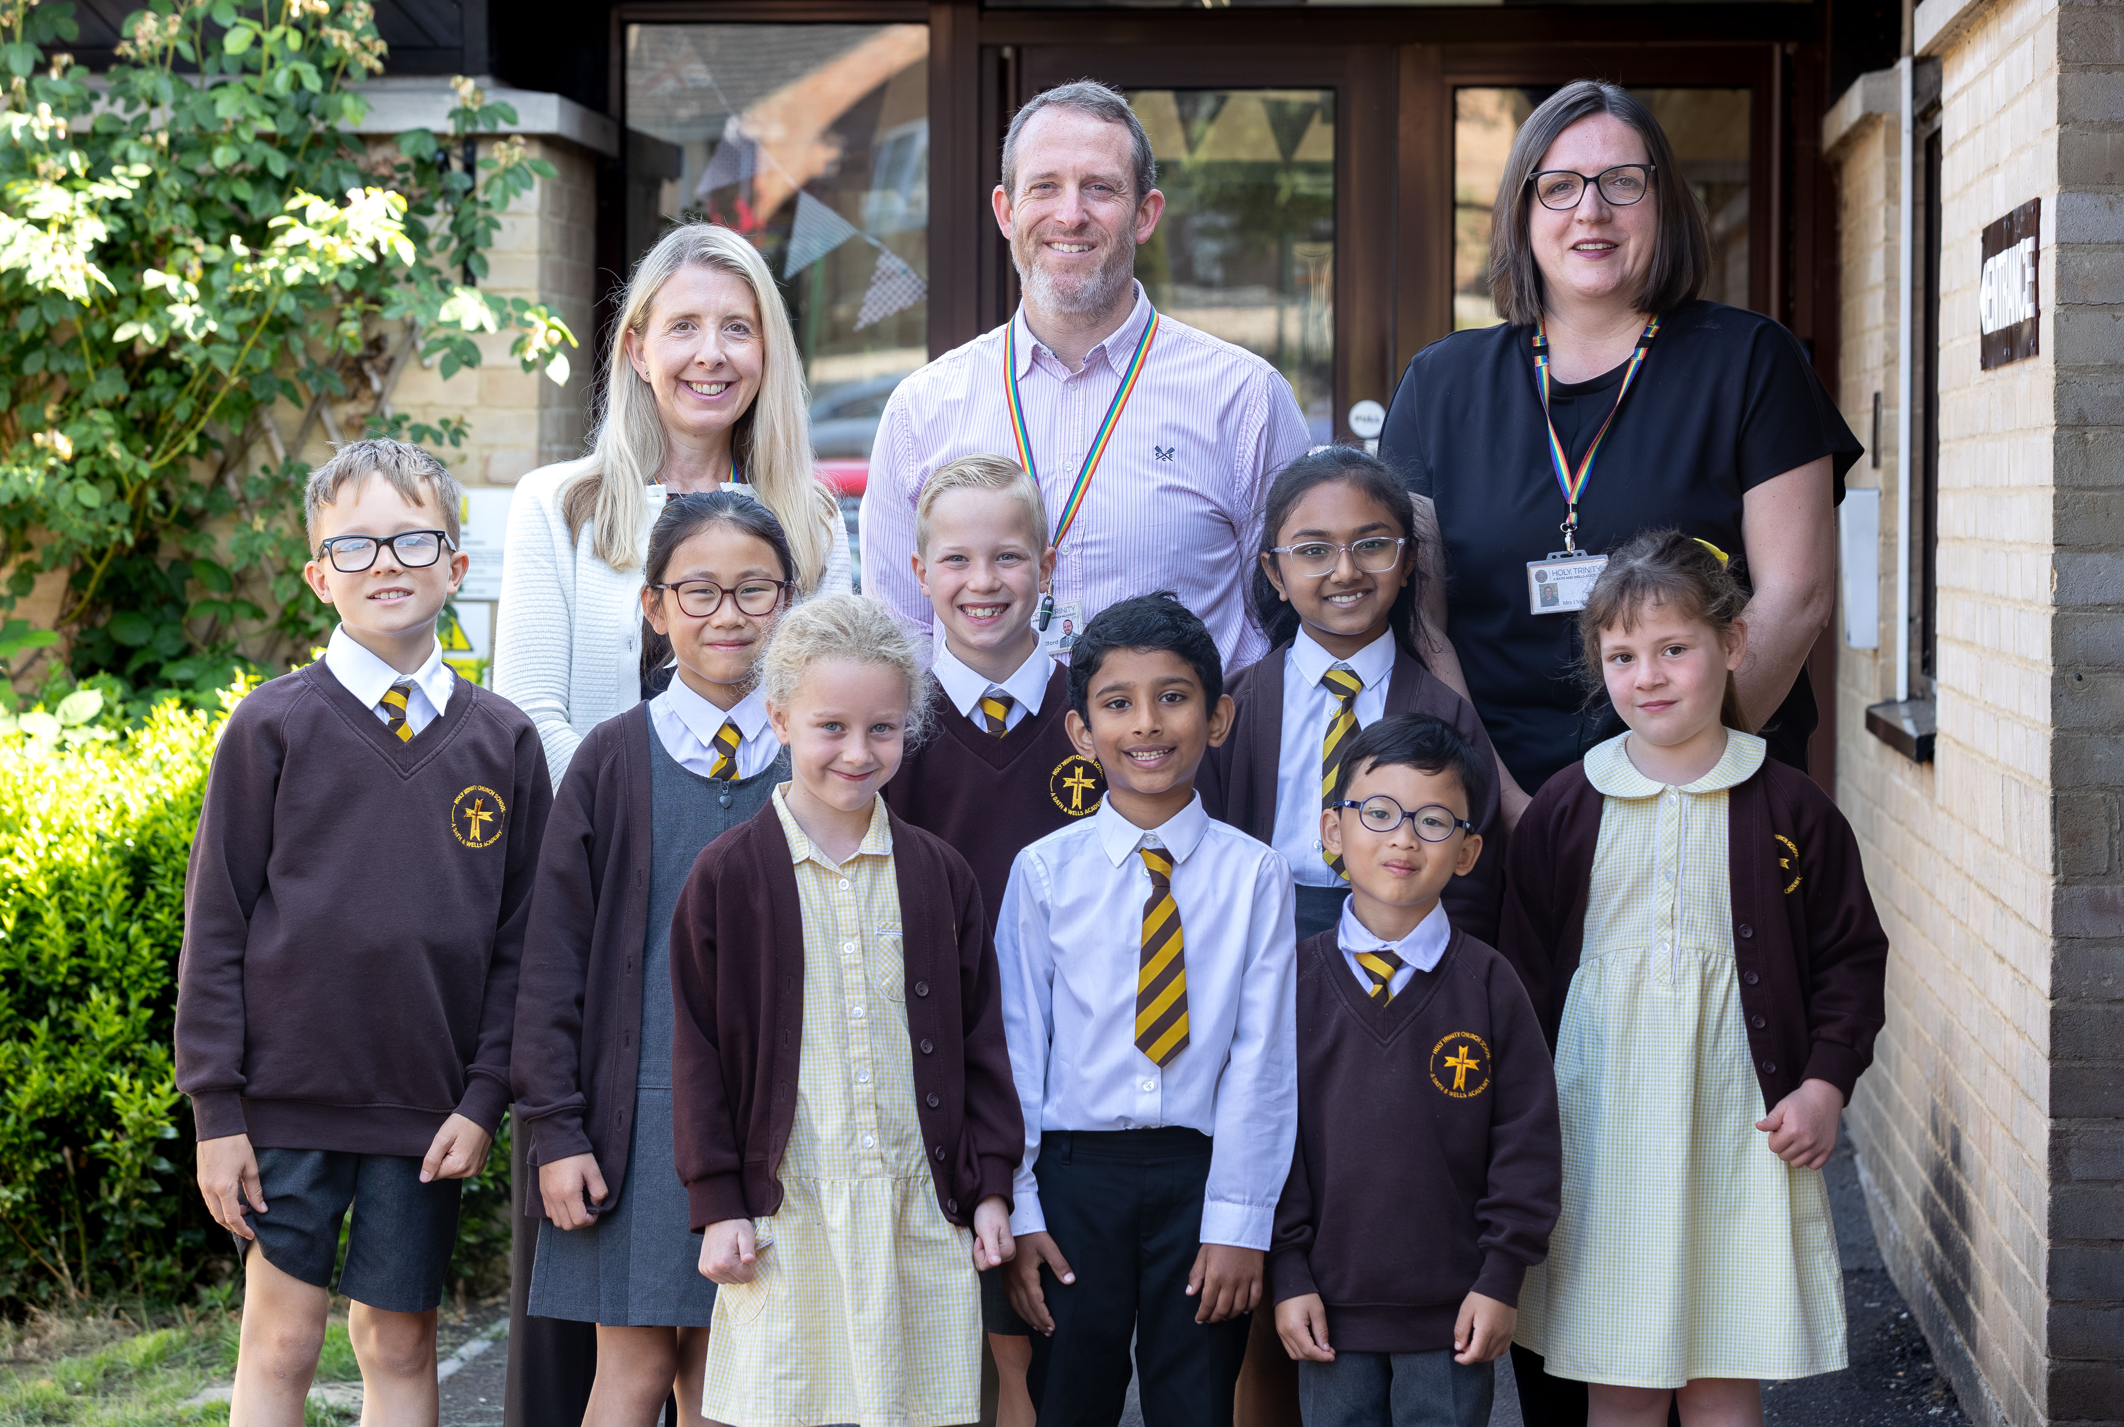
First day of school –
Monday 7th September 2026
To be in School Uniform
A Holy Trinity Book Bag
A water bottle

Slide 6
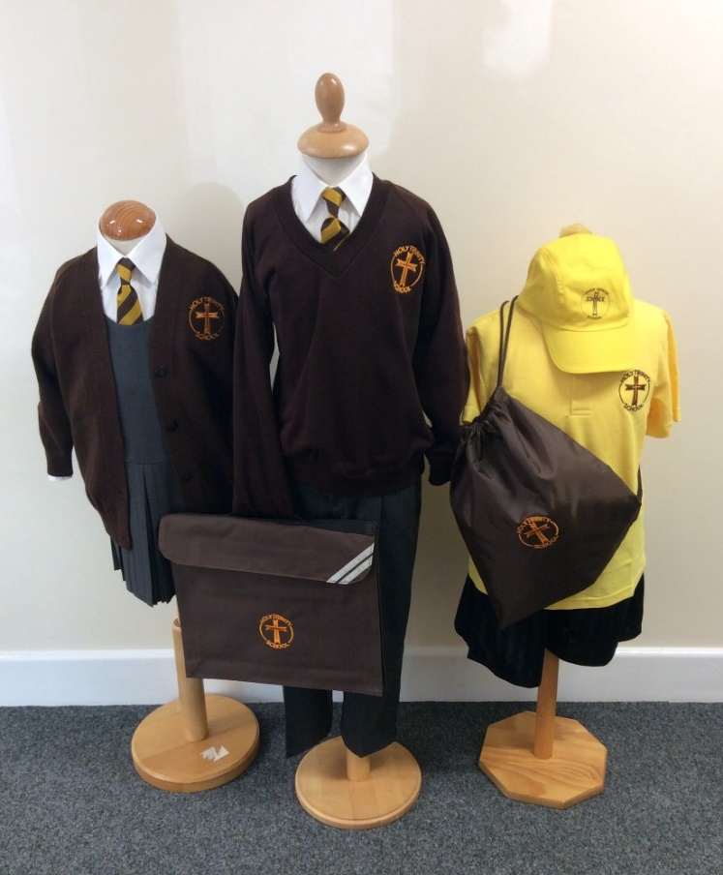
Uniform
This can be purchased from the School Wear Shop in town.
For Boys and Girls:
    Brown Jumper with School Logo
    School Tie
    White collared Shirt
    Black/Dark coloured School Shoes
    A Book Bag with School Logo
Boys:
    Grey/Black Trousers
    Grey / Black Shorts (Summer)
Girls:
    Grey/Black Skirt or Pinafore Dress
    Grey/Black tights or white socks
    Yellow and white checked dress (Summer)
    Shoulder length hair to be tied back at all times

Slide 7
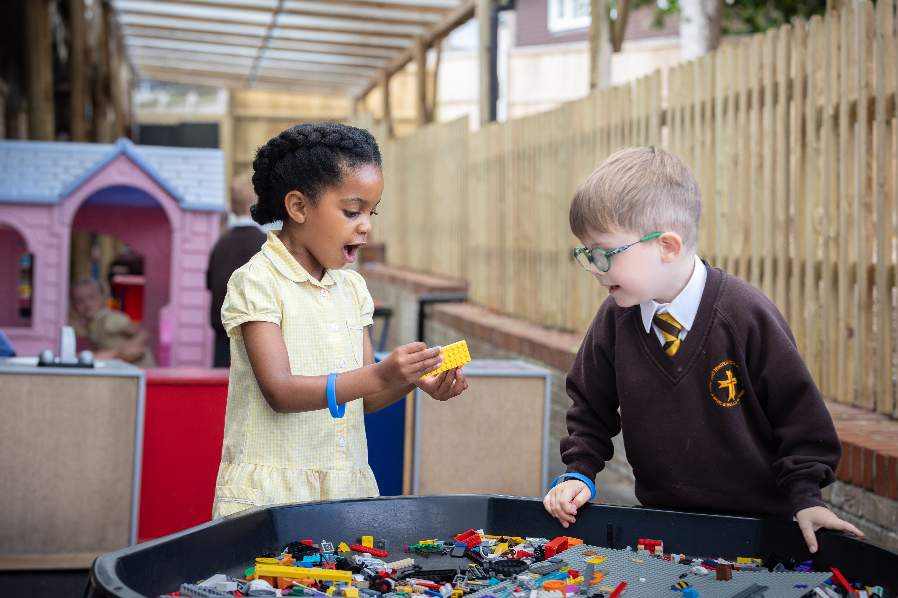
Breakfast Club and After School Club
There is a breakfast club which runs from 7.45 until 8.45
Need to contact the office for more information
After school club led by Louise and Tiff. Contact details can be found on our website.
There are also other childminders who collect
from school too.

Slide 8
Contact information
An email containing a link to an MS Form will be sent from the school office in the next few days.
Please complete ALL the details on this form as they are very important.
If you have any questions or you are unable to complete any part of this form, please contact the school office.
Please return the form As Soon As Possible.

Slide 9
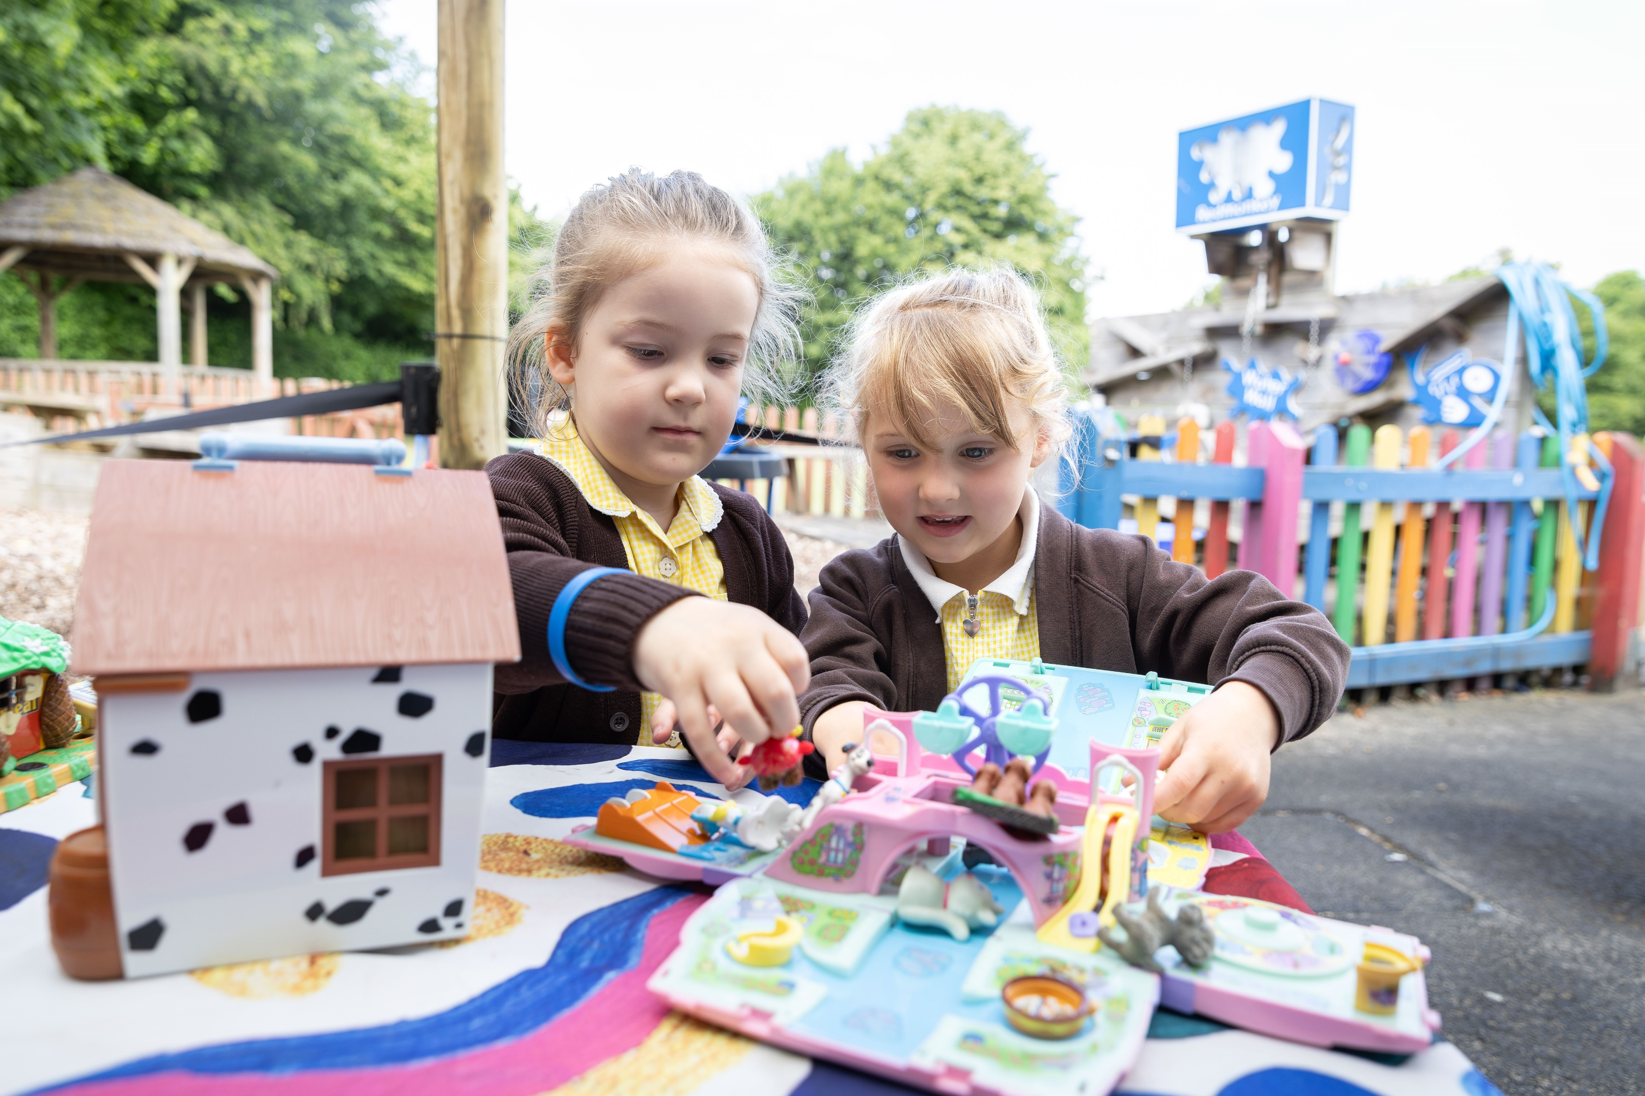
How can you help your child?
Skills to practise before starting Reception
New skills take time to learn. Practising at home will help your child move into school more easily and with confidence.
Growing independence
Putting on/taking off their coat and shoes
Using the toilet and washing their hands
Getting dressed with little help, e.g. after using the toilet or doing PE
Using cutlery and drinking from an open cup
Spending time away from you, learning they can be looked after by caring adults
More information and guidance can be found on www.startingreception.co.uk

Slide 10

Our School Website
www.holytrinitychurchschool.co.uk

Slide 11


Slide 12
About us
We are a registered charity run by a group of parents, our children range from reception to year 6
Our lifestyles vary but most of us work full-time and do what we can around our busy lives
We work closely with the school staff including Mr Beauford and the senior leadership team, the school office staff, teachers and teaching assistants and the governors
We organise the traditional school events that help to make the children’s school journey so special and create wonderful memories including the school discos and summer fete, etc. We are always looking for new and innovative ideas for fundraising activities and events
We raise a significant amount of money for the school which is spent on enhancing the children’s school experience

Slide 13
We have organised…
School disco
Summer fete
Easter bingo
Pre-loved uniform shop
Break the rules day
Bedtime stories
‘Treat Fridays’
Christmas bazaar
Santa visits

Slide 14
We have funded…
Ipads for the children to use
Year 6 leavers books
Bean bags for the library area
Royal coronation decorations & a commemorative gift for each child
Outdoor playground equipment
Helping Santa with his gifts
Enriching indoor & outdoor areas
In the last 6 years we have raised ~£50k for the school!
IT equipment

Slide 15

Join us!

Slide 16

A welcome from our Governors

Slide 17
Holy Trinity
Church School
WELCOME to the start of a journey together!

