Slide 1


Welcome to Year 5’s Curriculum Meeting

Slide 2
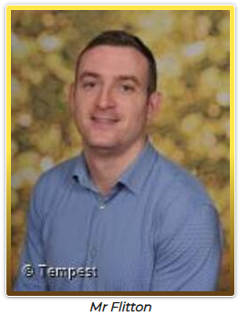
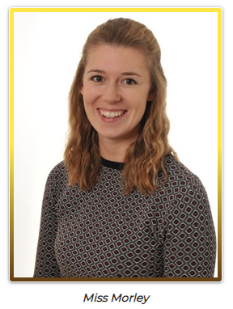

Year 5 Team

Slide 3

Topics
Autumn | Spring | Summer
The Victorians Earth and Space Christmas | Forces Geography Fieldwork Ancient Greece Materials | Intrepid Explorers Living things and their habitats Animals including humans

Slide 4
English
Daily fluency and Guided reading lessons.
    Reading skills, Literal, Inference, dictionary skills, language features
1 Target writing lesson and grammar lesson
3 Writing lessons
    Narrative, diary entries, newspaper reports, non-chronological reports, fables, instruction writing, letter writing
Spelling lessons, spelling test, dictation
Handwriting
Writing Skills

Slide 5
Reading
We aim to listen to your child read once a week, through our Guided Reading sessions.
We focus on fluency and comprehension.
Please read with your child 3 x a week and record this in their reading record.

Slide 6
Maths
Daily maths lesson.
    Lessons feature whole class teaching, paired work then an independent review to show their understanding.
A fortnightly arithmetic lesson.
Daily maths skills during registration.
Club Times Tables and TTR practice.

Slide 7
Other Curriculum Subjects
RE taught weekly – Christianity and Sikhism.
PSHE taught weekly, starting with ‘Being me in my world’. This is taught through the Jigsaw program which is new this year.
Computing, French and Music will be taught by the class teacher.
Music (clarinet lessons) is taught by Somerset Music.

Slide 8
PE
Class 11’s PE days will be Tuesdays and Thursdays.
Class 12’s PE days will be Wednesdays and Thursdays.
Please wear PE kit into school on these days (including earrings out or ear tape worn).
If there is a medical reason why they can’t take part in PE, please can you write a note to the teacher or else they will be expected to participate.

Slide 9
Homework
Homework will be set every Friday and will need to be returned and completed by the following Wednesday.
The children will collect points when they complete their homework.
Spellings will be sent home to learn and these should be practised throughout the week, ready for their spelling test which is on a Thursday.
Reading should be done frequently throughout the week, at least 3 times, in addition to the set homework.

Slide 10
General Reminders
Children should bring their reading books into school every day.
Please name uniform, coats, water bottles, lunch boxes etc.
Children can bring in a snack for break time.
As we move into the Autumn Term, please ensure your child has a coat (with a hood and clearly named) with them every day.

Slide 11
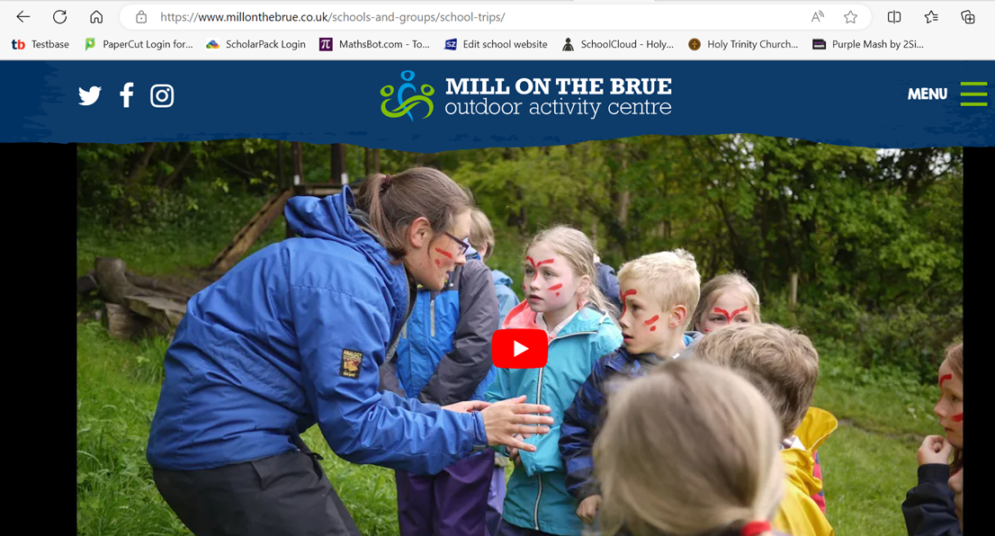
Mill on the Brue
Monday 22nd March – Wednesday 24th March 2027
https://www.millonthebrue.co.uk/schools-and-groups/school-trips/

Slide 12
Thank you
If you have any issues, please come and speak to us at the door or email the school office: office@holytrinity.bwmat.org

