Slide 1


Welcome!
Curriculum Meeting for Parents of Children in Reception

Slide 2
Staff names and locations
Mrs Salvetti and Mrs Grayson – Class 1
Mrs Veryard and Mrs Harris – Class 2
Miss Hooper, Mrs Freeman and Mrs Way

Slide 3

During their first few days at school…
Your child has been settling into the routines of school life with so much information to remember and digest. They have done very well!
Gaining independence, for example, changing into their PE kits and having a go at doing up their shirt buttons.
Meeting new friends and talking with them as well as meeting different adults around the school.
Finding their way around the school, for example, going into the school hall to eat lunch.
Getting to know the staff in the school during playtimes and lunchtimes.

Slide 4
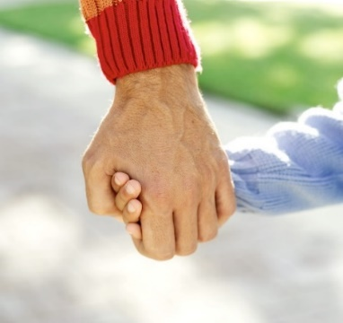
A partnership…
Sometimes things can be difficult, and we understand this. Communication between you and us is extremely important.
Please talk to us if there are any concerns, worries or questions.
No question is too small or silly, we understand how little things can make us all worry. If there is anything which you are unsure of, please ask us.
Achievement display board outside of Class 1 for certificates and celebrations such as moving onto a new swimming stage or certificates for football or gymnastics. We want to know all about the children’s successes out of school.
Coming soon! - Tapestry to show what your child has been doing at school.

Slide 5
Phonics - Terminology
Phoneme
Blend
Grapheme
Segment
Digraph
Trigraph
Notes:
Slide purpose:
To give simple definitions of key terminology
Notes:
Explain what each word means – use the Glossary to help.

Slide 6
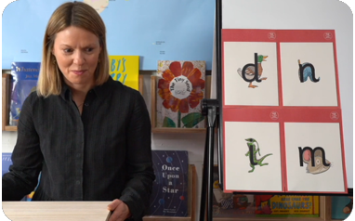
This term we are teaching Phase 2
These are the first group of letters and sounds your child will learn.
We start teaching from week 2 of Reception.
The lessons are fun, interactive, engaging and have been designed to gradually build over time.
Notes:
Slide purpose:
To introduce Phase 2
Notes
Read the slide.

Slide 7
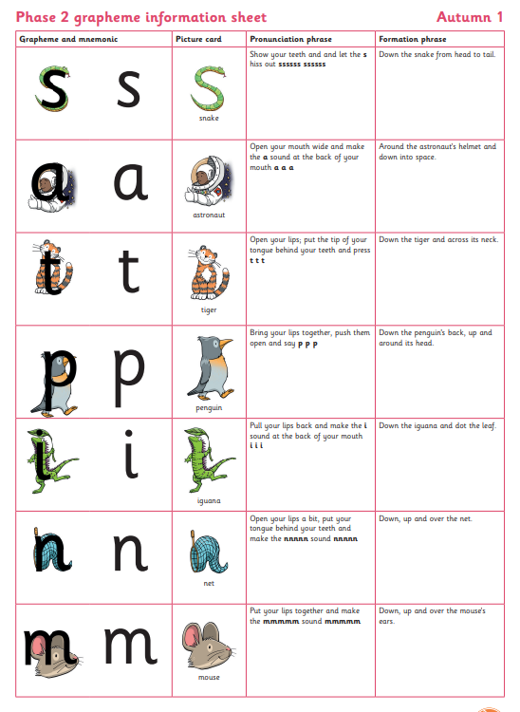
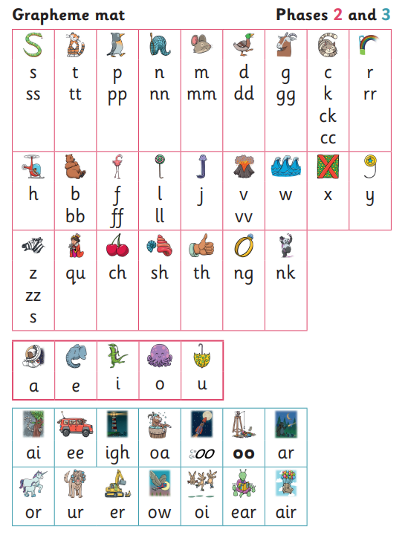
Grow the Code
Please see the school website for more phonics information, or follow the link below.
For parents | Letters and Sounds (littlewandlelettersandsounds.org.uk)

Slide 8
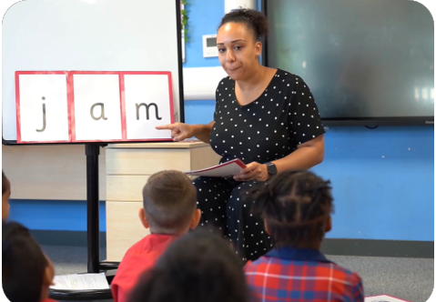
We teach blending so your child learns to read
Teacher-led blending is taught throughout Phase 2.
Our aim to is to teach every child to blend by Christmas.
We will inform you if your child needs additional practice.
Notes:
Slide purpose:
To introduce blending
Suggested script:
Teacher-led blending is teaching children how to blend, directed and demonstrated by the teacher.
It is repeated daily in the Autumn term.

Slide 9

Blending to read words
Notes:
Slide purpose:
To provide an overview of blending
Suggested script:
Some children learn to blend really quickly, and others take a little longer.
If your child is finding it difficult, ask your child’s teacher for ways to help at home – playing blending games at home is so helpful!
Show parents the ‘How we teach blending’ video from ‘For parents’ area of the website: https://www.littlewandlelettersandsounds.org.uk/resources/for-parents/

Slide 10
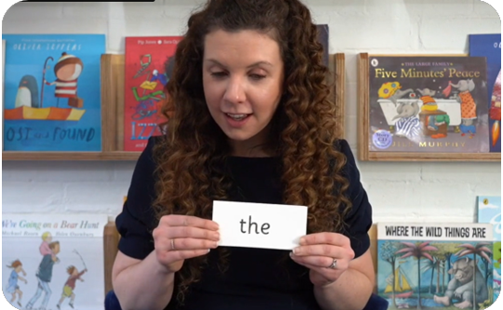
Tricky words
These are taught in our daily Phonics sessions. They are words which have unusual spellings that the children cannot 'sound out' examples are - he, and was.
They are taught in a systematic way and introduced slowly to the children in order to help them remember and recognise each word accurately.
Children are now learning to read the Phase 2 tricky words: is, I, the, put, pull, full, as, and, has, his, her, go, no, to, into, she, push, he, of, we, me, be.
Notes:
Slide purpose:
To introduce tricky words
Notes:
Read the slide.
You may wish to give parents a copy of the document ‘Phase 2 tricky words: Reception Autumn term – Information for parents and carers'.

Slide 11
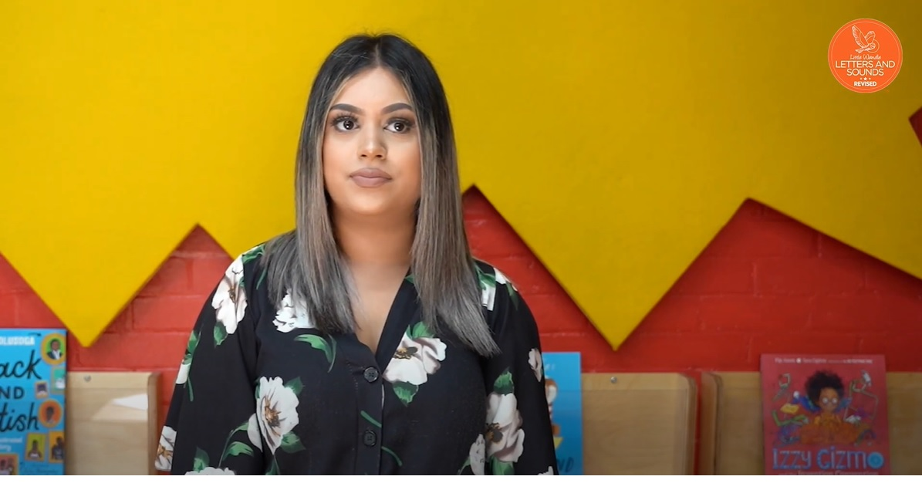
Reading tricky words
Notes:
Slide purpose:
To provide an overview of tricky words
Notes
Watch the ‘How we teach tricky words’ video on the website: https://www.littlewandlelettersandsounds.org.uk/resources/for-parents/

Slide 12

Reading at school and at home…
Children learn to read using a variety of books – not necessarily books which are provided through school.
Your child’s reading book links to their letter sound knowledge and this is tested regularly. To start with, this will be a book without words.
Your child will be heard read in a group once during the week.
A comment or stamp will be placed in your child’s diary when they have read in school.
We would like you to write a comment or sign the diary when you hear your child read at home. This is important to see how your child is getting on with reading at home.
Reading books to your child regularly.

Slide 13

How do we find the right book for your child?
Notes:
Slide purpose:
To introduce book matching
Suggested script:
We assess your child every six weeks to check progress.
Any child who needs extra support has Daily Keep-up sessions planned for them.

Slide 14
Listening to your child read their phonics book
Your child should be able to read their book without much help as we practice this book in school twice before they bring them home to you.
They will slowly sound out words and blend them together before they read fluently.
If they can’t read a word and have tried really hard, read it to them.
Talk about the book and what happens in the story.
Don’t forget to celebrate their success!
Notes:
Slide purpose:
To give guidance on reading the decodable book at home
Notes
Read the slide.

Slide 15
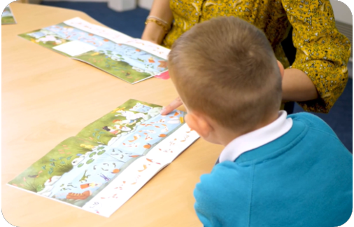
Reading a wordless book
Wordless books are invaluable as they teach reading behaviours and simple comprehension to children who are not blending – yet!
Talk about the pictures and ask your child what they think is happening? Does that person look happy or sad? Why?
Point to the images and ask the children to name the people and objects.
Encourage your child to make links from the book to their experiences. For example, ‘oh look Dad is making a cake, can you remember when we made a cake?’
Notes:
Slide purpose:
To give guidance on reading wordless books at home
Notes:
Read the slide.

Slide 16
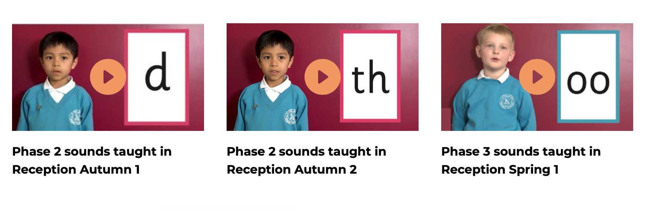
Supporting your child with phonics
Notes:
Slide purpose:
To give guidance on supporting phonics learning at home
Suggested script:
It is really important that you pronounce the sounds correctly at home if you are supporting your child.
Use the videos we saw earlier for support.

Slide 17

Writing…
Progression – what should you expect to see as the year unfolds?
Holding a pencil correctly.
Using the 'Grow the Code' mat which is available on our website and we send home copies in book bags.
Making marks, letter formation, simple words and then sentence construction towards the Summer Term.
Exciting, practical opportunities to write within play.
Effort grades, purple tickets & golden tickets for presentation.

Slide 18
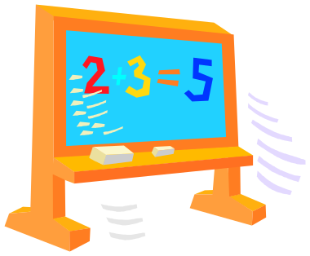
Mathematics…
At the beginning we will focus on number. This will include using the number formation, counting, ordering, one to one correspondence.
Subitising! Learning to see the pattern and say how many there is without counting.
The children will be working with numbers to 5 then 10 and up to 20 when ready.
This will then lead onto simple addition and subtraction, using pictures to help at first and then completing their own calculations. The children will have number lines and tens frames to help them.
The children will also look at shapes and measures, this will involve looking at pattern, comparing objects, time and money.

Slide 19

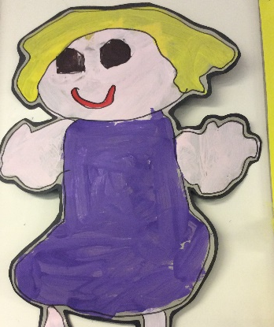
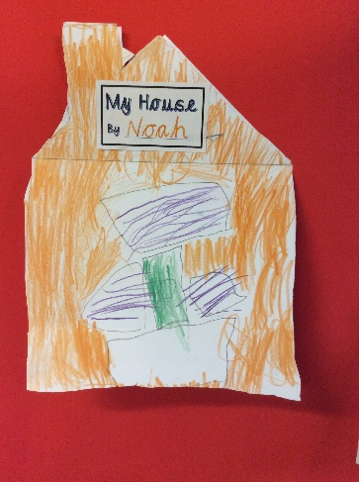
Other areas of the Foundation stage…
The children will be completing other areas of EYFS such as Understanding the World, Expressive Arts and Design and Physical Development through a topic-based approach.
Our topic this half term is 'All about me' where we have been using our All about me books to share photos of our family and pets, as well as our favourite foods and activities!
Observations will be recorded to monitor and evidence progression in these areas of the EYFS profile via Tapestry.
There are 17 Early Learning Goals to achieve by the end of EYFS.
If your child has not met all of these goals, please do not worry, each child has different strengths, for example, some children are great at PE and others can be very artistic.

Slide 20

Please don’t forget…..
Your child needs:
Named school uniform.
A water bottle with water please.
PE days are on a Tuesday for Class 1 and Wednesday for Class 2 and both classes will have PE on Friday. The children will get changed in school.
Book Bag.
A coat when it looks like rain.
You need:
To tell us if there are ANY worries, concerns or questions
Write/ sign in your child’s reading diary when you hear them read at home
Keep practicing the letter sounds, writing their name, recognising and writing numbers – every little helps!

